Slide 1
Taxi Fare Amount Dataset Presentation
By : Group 3
Mahmoud Ayman Samir
Hana Alaaeldin Saleh
Mahmoud shawky

Slide 2
Table Of Contents
01
02
03
04
Introduction & Objective
Dataset Overview
Data Structure & Exploration
Handling Missing Values
Understanding the purpose of analyzing NYC taxi fare data
General description of the dataset & key attributes
Understanding the dataset's structure and format
leaning up incomplete data to improve analysis accuracy

Slide 3
Table Of Contents
05
06
07
08
Handling Outliers
Feature Engineering
Key Insights from EDA
Conclusion
Detecting and managing extreme values that distort analysis
Creating new meaningful variables to enhance insights
Analyzing relationships between fare amount & other features
Summarizing key takeaways

Slide 4
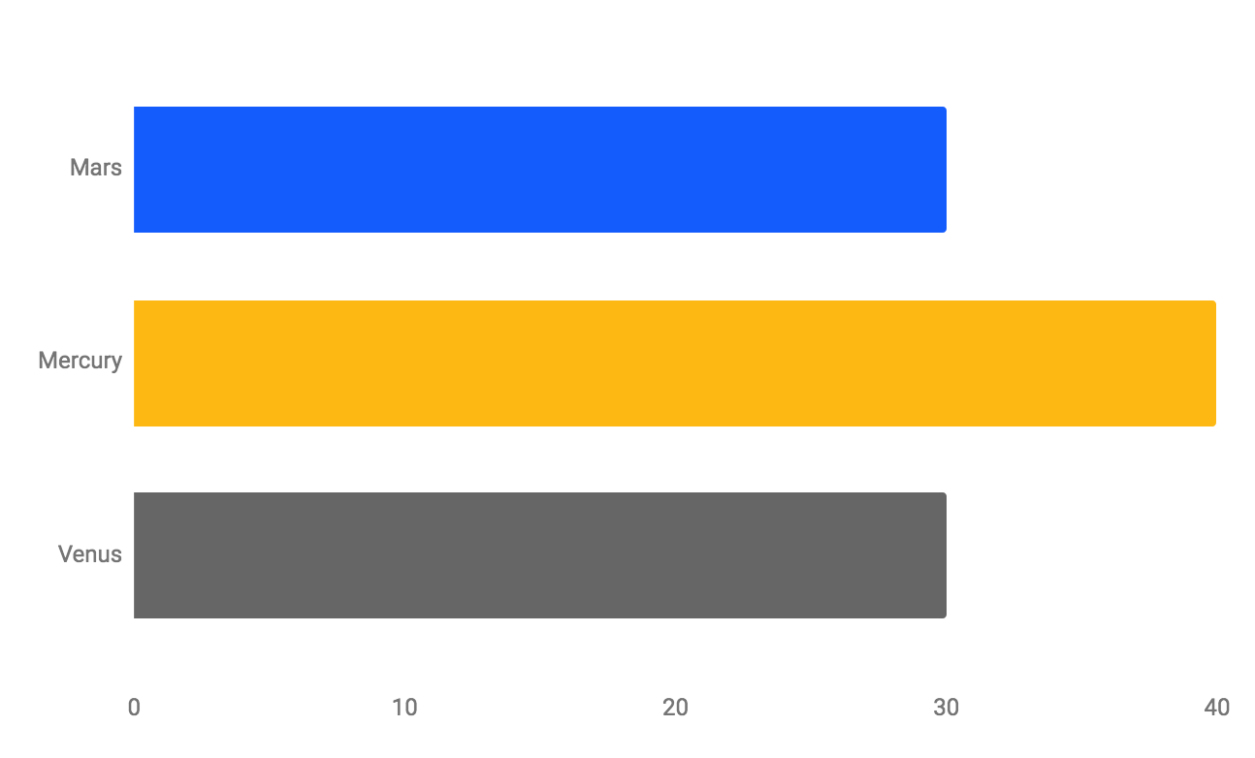
Introduction & Objective
The aim of this dataset is to provide a comprehensive collection of taxi rides in New York City, helping in:
Understanding fare calculation based on key ride parameters.
Identifying key factors affecting fare prices (e.g., distance, weather, time).
Developing predictive models to estimate fare amounts.

Slide 5
Dataset Overview
Dataset Information
Key Data Categories
01
Dataset Name: New York Taxi Fare Dataset
Total Records: 500,000 taxi trips
Data Source: New York City Taxi Service
Number of Columns: 26
Number of Rows: 500,000
Ride Details: Fare, passengers, trip distance
Time Features: Pickup time, hour, day, month, year
Location & Distance: Landmarks (JFK, NYC Center), bearing
External Factors: Weather, traffic, car condition
Identifiers: Unique trip key
02

Slide 6
Data Structure & Exploration
This dataset provides a rich combination of temporal, geospatial, and categorical data, making it highly valuable for predictive analysis, pricing strategies, and ride demand forecasting.
Column Name | Non-Null Count | Dtype | Description
User ID | 500,000 | object | Unique identifier for each user
User Name | 500,000 | object | Name of the user
Driver Name | 500,000 | object | Name of the taxi driver
Car Condition | 500,000 | object | Condition of the taxi car
Weather | 500,000 | object | Weather conditions during the trip
Traffic Condition | 500,000 | object | Traffic conditions during the trip
key | 500,000 | object | Unique identifier for each trip
fare_amount | 500,000 | float64 | The fare amount charged for the trip

Slide 7
Data Structure & Exploration
This dataset provides a rich combination of temporal, geospatial, and categorical data, making it highly valuable for predictive analysis, pricing strategies, and ride demand forecasting.
Column Name | Non-Null Count | Dtype | Description
pickup_datetime | 500,000 | object | Date and time when the trip started
pickup_longitude | 500,000 | float64 | Longitude coordinate of the pickup location
pickup_latitude | 500,000 | float64 | Latitude coordinate of the pickup location
dropoff_longitude | 500,000 | float64 | Longitude coordinate of the dropoff location
dropoff_latitude | 500,000 | float64 | Latitude coordinate of the dropoff location
passenger_count | 500,000 | int64 | Number of passengers in the taxi
hour | 500,000 | int64 | Hour of the day when the trip started
day | 500,000 | int64 | Day of the month when the trip started

Slide 8
Data Structure & Exploration
This dataset provides a rich combination of temporal, geospatial, and categorical data, making it highly valuable for predictive analysis, pricing strategies, and ride demand forecasting.
Column Name | Non-Null Count | Dtype | Description
weekday | 500,000 | int64 | Day of the week when the trip started
year | 500,000 | int64 | Year when the trip started
jfk_dist | 499,995 | float64 | Distance from pickup to John F. Kennedy International Airport
ewr_dist | 499,995 | float64 | Distance from pickup to Newark Liberty International Airport
lga_dist | 499,995 | float64 | Distance from pickup to LaGuardia Airport
sol_dist | 499,995 | float64 | Distance from pickup to the Statue of Liberty
nyc_dist | 499,995 | float64 | Distance from pickup to the center of New York City
distance | 499,995 | float64 | Total distance of the trip

Slide 9
Handling Missing & Invalid Values
Missing Values
Invalid Values
01
Drop-off coordinates, distances to landmarks.
Impact: Only 0.001% missing data → Safe to drop rows.
100% invalid pickup & dropoff coordinates ➝ Dropped Columns
Longitude, Latitude (Pickup & Dropoff)
Negative Fare Amounts (-$44.90) ➝ Removed
Passenger Count = 0 ➝ Replaced with 1
02

Slide 10
Handling Missing & Invalid Values
Statistic | fare_amount | pickup_longitude | pickup_latitude | dropoff_longitude | dropoff_latitude | passenger_count | hour | day
count | 500000 | 500000 | 500000 | 499995 | 499995 | 500000 | 500000 | 500000
mean | 11.358 | -1.2657 | 0.6967 | -1.2658 | 0.6967 | 1.6834 | 13.51 | 15.68
std | 9.9166 | 0.2069 | 0.1409 | 0.2059 | 0.1290 | 1.3074 | 6.5116 | 8.6811
min | -44.90 | -52.12 | -54.39 | -59.05 | -44.68 | 0.0000 | 0.0000 | 1.0000
25% | 6.0000 | -1.2914 | 0.7110 | -1.2914 | 0.7109 | 1.0000 | 9.0000 | 8.0000
50% | 8.5000 | -1.2912 | 0.7113 | -1.2912 | 0.7113 | 1.0000 | 14.00 | 16.00
75% | 12.5000 | -1.2910 | 0.7115 | -1.2909 | 0.7115 | 2.0000 | 19.00 | 23.00
max | 500.00 | 37.36 | 29.72 | 0.7130 | 7.0619 | 6.0000 | 23.00 | 31.00
Fare Amount (fare_amount)
Min: -44.90 (Negative fares are unlikely unless it's a refund or error).
Max: 500.00 (A high fare, but possibly valid for a long-distance trip).
🚨 Action: Remove negative fare values.

Slide 11
Handling Missing & Invalid Values
Statistic | fare_amount | pickup_longitude | pickup_latitude | dropoff_longitude | dropoff_latitude | passenger_count | hour | day
count | 500000 | 500000 | 500000 | 499995 | 499995 | 500000 | 500000 | 500000
mean | 11.358 | -1.2657 | 0.6967 | -1.2658 | 0.6967 | 1.6834 | 13.51 | 15.68
std | 9.9166 | 0.2069 | 0.1409 | 0.2059 | 0.1290 | 1.3074 | 6.5116 | 8.6811
min | -44.90 | -52.12 | -54.39 | -59.05 | -44.68 | 0.0000 | 0.0000 | 1.0000
25% | 6.0000 | -1.2914 | 0.7110 | -1.2914 | 0.7109 | 1.0000 | 9.0000 | 8.0000
50% | 8.5000 | -1.2912 | 0.7113 | -1.2912 | 0.7113 | 1.0000 | 14.00 | 16.00
75% | 12.5000 | -1.2910 | 0.7115 | -1.2909 | 0.7115 | 2.0000 | 19.00 | 23.00
max | 500.00 | 37.36 | 29.72 | 0.7130 | 7.0619 | 6.0000 | 23.00 | 31.00
Pickup Longitude:
Min: -52.119764
Max: 37.360538 (Longitude values in NYC should be between -74 and -73).
Pickup Latitude:
Min: -54.389440
Max: 29.724576 (Latitude values in NYC should be between 40 and 41).
Dropoff Longitude:
Min: -59.049665
Max: 0.712985 (Again, unrealistic).
Dropoff Latitude:
Min: -44.676047
Max: 7.061893

Slide 12
Handling Missing & Invalid Values
Statistic | fare_amount | pickup_longitude | pickup_latitude | dropoff_longitude | dropoff_latitude | passenger_count | hour | day
count | 500000 | 500000 | 500000 | 499995 | 499995 | 500000 | 500000 | 500000
mean | 11.358 | -1.2657 | 0.6967 | -1.2658 | 0.6967 | 1.6834 | 13.51 | 15.68
std | 9.9166 | 0.2069 | 0.1409 | 0.2059 | 0.1290 | 1.3074 | 6.5116 | 8.6811
min | -44.90 | -52.12 | -54.39 | -59.05 | -44.68 | 0.0000 | 0.0000 | 1.0000
25% | 6.0000 | -1.2914 | 0.7110 | -1.2914 | 0.7109 | 1.0000 | 9.0000 | 8.0000
50% | 8.5000 | -1.2912 | 0.7113 | -1.2912 | 0.7113 | 1.0000 | 14.00 | 16.00
75% | 12.5000 | -1.2910 | 0.7115 | -1.2909 | 0.7115 | 2.0000 | 19.00 | 23.00
max | 500.00 | 37.36 | 29.72 | 0.7130 | 7.0619 | 6.0000 | 23.00 | 31.00
Passenger Count (passenger_count)
Min: 0 (Is this an empty ride? 🤔)
Max: 6 (This is reasonable since most taxis allow up to 6 passengers).
🚨 Action: Remove rows where passenger_count == 0.

Slide 13
Handling Missing & Invalid Values
Statistic | month | weekday | year | jfk_dist | ewr_dist | lga_dist | sol_dist | nyc_dist | distance | bearing
count | 500000 | 500000 | 500000 | 499995 | 499995 | 499995 | 499995 | 499995 | 499995 | 499995
mean | 6.27 | 3.04 | 2011.74 | 385.28 | 380.50 | 363.84 | 363.67 | 355.99 | 19.47 | 0.2971
std | 3.4378 | 1.9492 | 1.8609 | 2419.09 | 2428.80 | 2425.08 | 2428.35 | 2428.73 | 367.30 | 1.8045
min | 1.0000 | 0.0000 | 2009.00 | 1.02 | 1.46 | 0.38 | 0.53 | 0.08 | 0.0000 | -3.1416
25% | 3.0000 | 1.0000 | 2010.00 | 41.34 | 32.17 | 17.10 | 14.89 | 7.15 | 1.2146 | -0.8547
50% | 6.0000 | 3.0000 | 2012.00 | 42.52 | 34.79 | 19.59 | 18.35 | 10.46 | 2.1170 | -0.0504
75% | 9.0000 | 5.0000 | 2013.00 | 43.79 | 38.30 | 22.21 | 22.42 | 14.45 | 3.8901 | 2.2068
max | 12.0000 | 6.0000 | 2015.00 | 30133.07 | 30167.60 | 30167.29 | 30159.41 | 30162.29 | 12399.96 | 3.1416
Distance-Related Columns
JFK, EWR, LGA Distances:
Max values exceed 30,000 miles, which is impossible.
Ride Distance (distance)
Max: 12,399.95 miles (Way too high—possibly a data error).
🚨 Action: Cap realistic distances (JFK/EWR/LGA to ≤30 miles, ride distance to ≤200 miles).

Slide 14
Handling Outliers
1
2
4
Extreme Fare Outliers Identified
Distance-Based Anomalies
Extreme Airport Distances
❌ JFK, EWR, LGA distances > 30,000 miles 🚀 (Invalid)
✅ Capped using IQR Method
❌ Minimum: -44.90$ (Incorrect)
✅ Maximum: $500 (Valid for premium rides)
❌ Max Ride Distance: 12,399 miles 🚀 (Impossible!)
✅ Filtered Trips between 0.1 - 200 miles

Slide 15
Feature Engineering
Temporal Features
Distance Features
Binned Trips into Categories: [Very Short, Short, Medium, Long, Very Long, Extreme]
Price per Mile Calculation
Extracted: Hour, Day, Month, Year, Quarter, Weekday.
Time of Day Categories: Night, Morning, Afternoon, Evening.
Flags: Rush Hour Indicator, Weekend Indicator.
Directional Feature
Encoding
Ride Bearing Transformed into Cardinal Directions (e.g., North, South)
Ordinal Encoding: Car Condition, Traffic Severity, Distance Bin.
One-Hot Encoding: Weather, Time of Day.

Slide 16
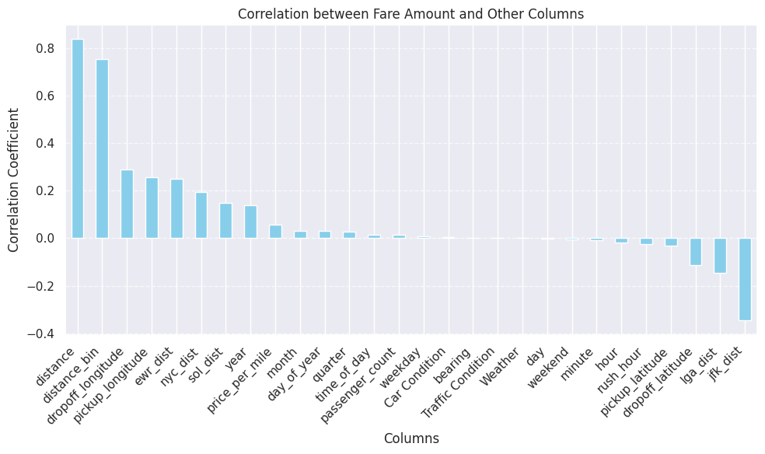
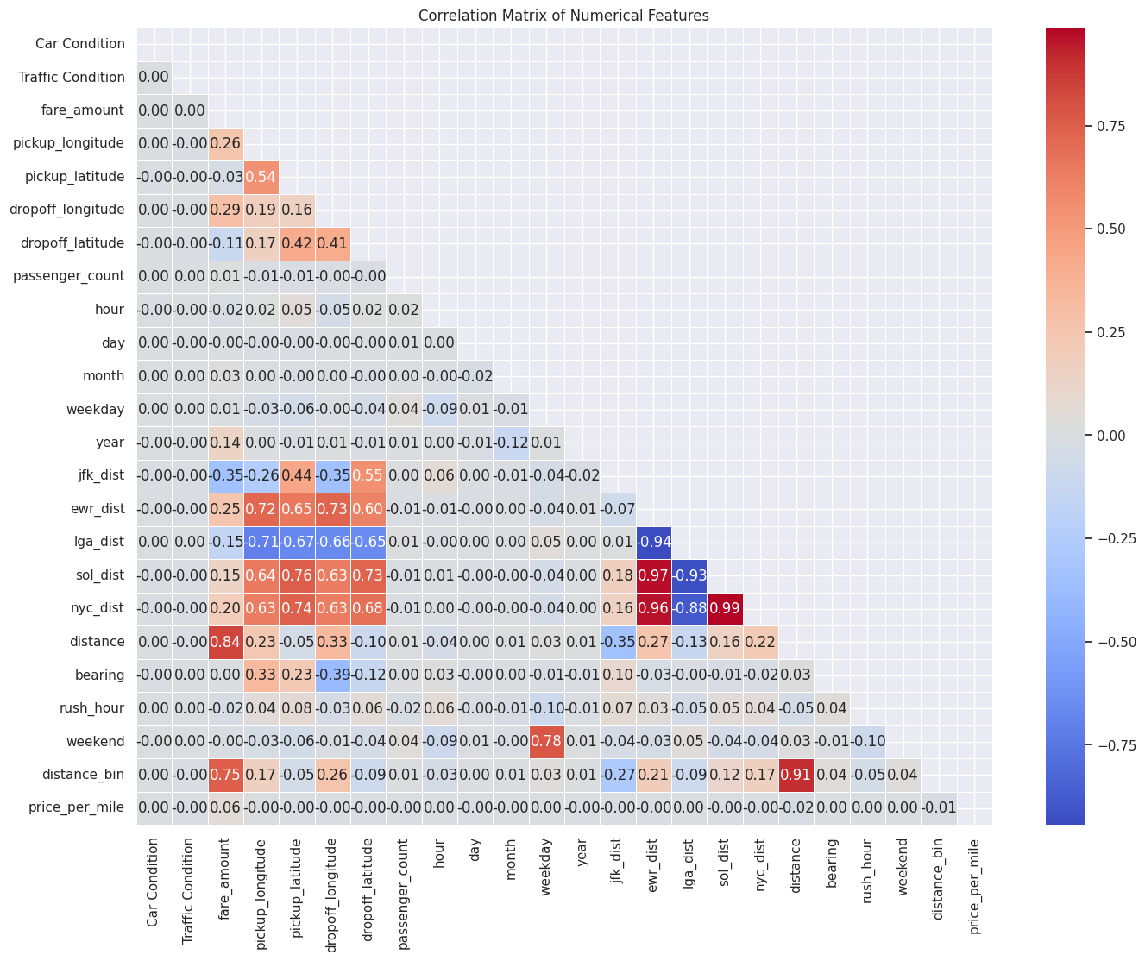
Key Insights from Correlation Analysis
Distance is the strongest fare predictor (0.83 correlation)—longer trips lead to higher fares.
Pickup/Dropoff Locations matter, especially in Manhattan and airport routes.
Airport Distances show mixed effects, with JFK fares lower due to flat-rate pricing.
Time-based features (hour, weekday, rush hour) have minimal impact on fare variation.
External factors (weather, traffic, car condition) show weak correlations, suggesting NYC taxis don’t adjust fares significantly for them.

Slide 17
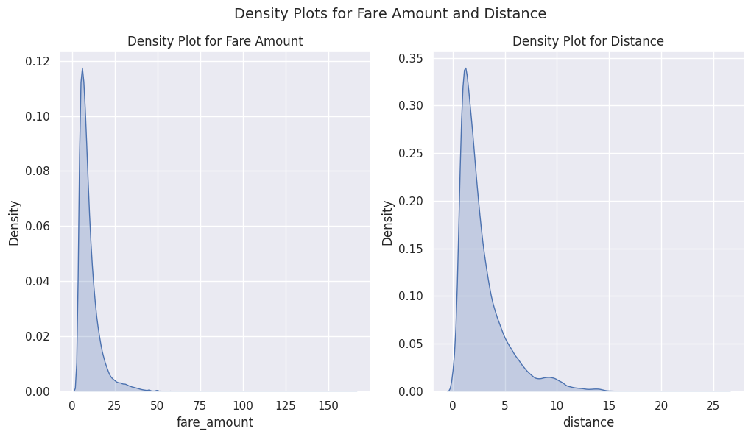
Key Insights from Density Plots
Both fare amount and trip distance are highly skewed, with most values concentrated on the lower end.
Majority of fares are below $25, suggesting that most taxi trips are short rides.
Most trips have a distance under 5 miles, indicating a concentration of short intra-city rides.
There are a few high-fare and long-distance rides, but they are rare compared to typical trips.

Slide 18
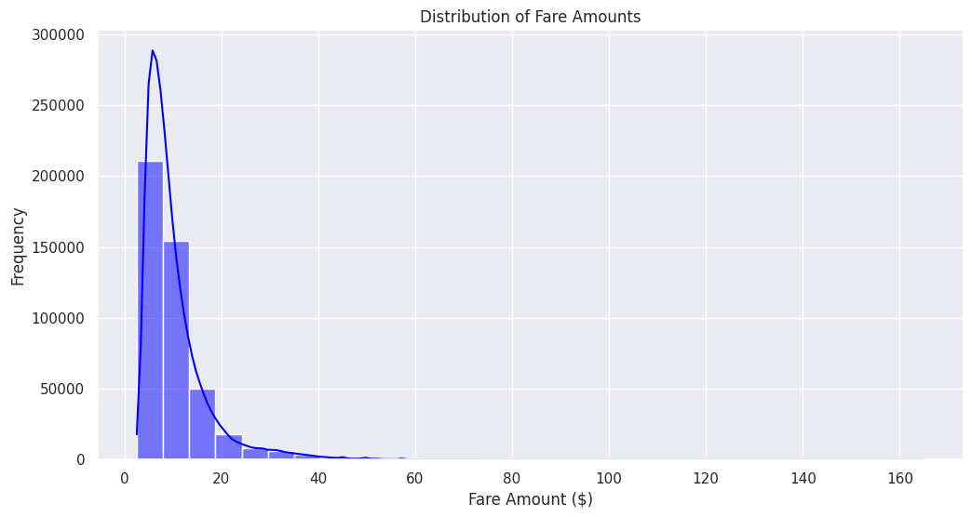
Key Insights: Fare Amount Distribution
Most fares are under $20, indicating that short-distance trips dominate the dataset.
The distribution is highly skewed, with fewer high-fare rides.
A small number of fares exceed $100, likely long-distance or premium service rides.
Conclusion: Taxi rides in NYC are generally short and affordable, with a few high-fare outliers.

Slide 19
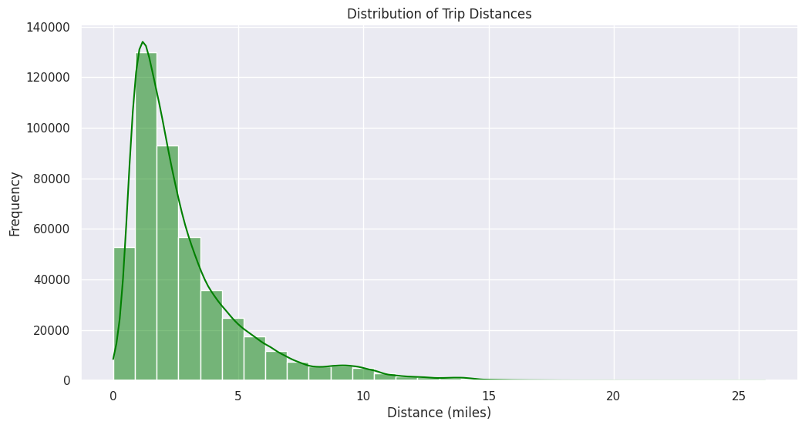
Key Insights: Trip Distance Distribution
Most trips are short, with the majority under 5 miles, indicating frequent short-distance travel.
The distribution is right-skewed, with fewer long trips beyond 10 miles.
Rare long-distance trips exist, likely to airports or outer boroughs.
Conclusion: NYC taxi trips are predominantly short, with a few long rides contributing to higher fares.

Slide 20
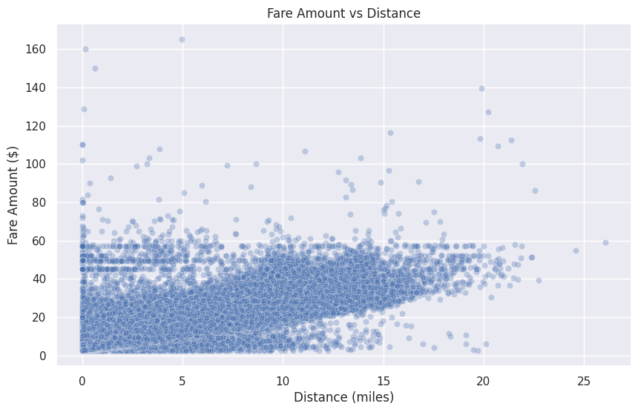
Key Insights: Fare vs Distance
Fares increase with distance, confirming distance as the main pricing factor.
Short trips (<5 miles) show wide fare variation, likely due to minimum charges or surge pricing.
Flat-rate fares (~$50, ~$70) suggest fixed airport pricing.
Some high-fare outliers exist, possibly due to premium services or anomalies.
Conclusion: Distance drives fare, but pricing isn't purely linear due to minimum fares, airport rates, and demand-based pricing.

Slide 21
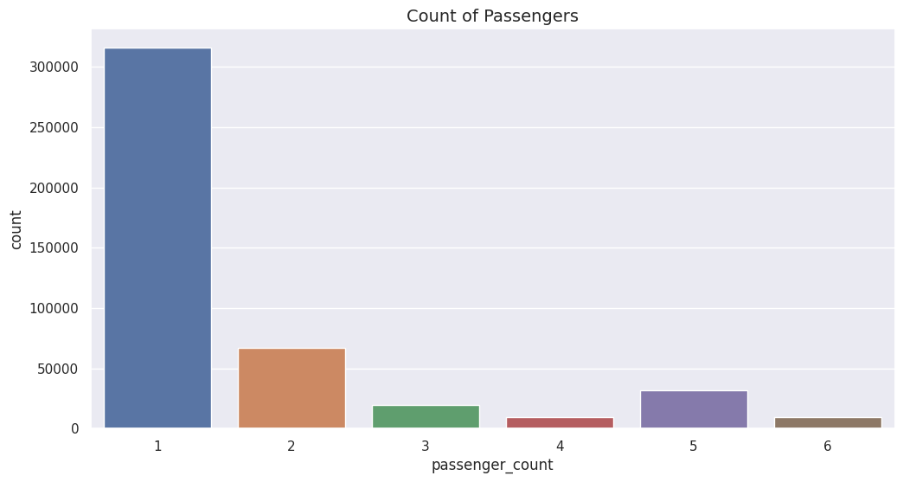
Key Insights: Passenger Count Distribution
Most trips (over 60%) are single-passenger rides, indicating high individual taxi usage.
Two-passenger rides are the second most common, while larger groups (3-6 passengers) are rare.
Group rides (5-6 passengers) occur less frequently, possibly due to vehicle capacity limits.
Conclusion: Taxis are primarily used for solo travel, with few shared/group rides.

Slide 22
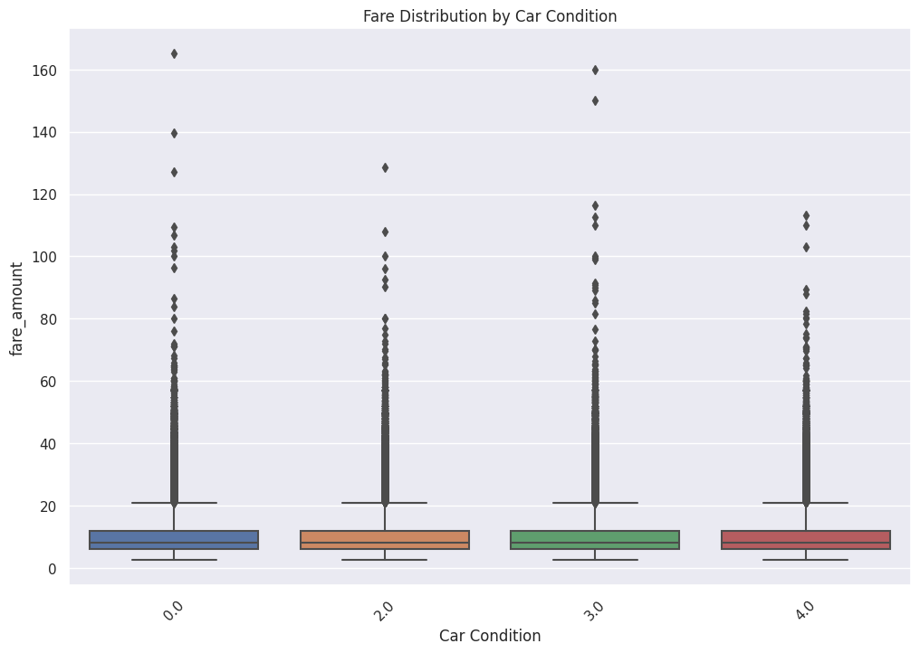
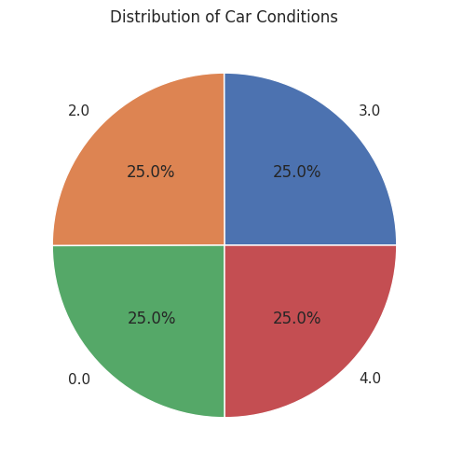
Key Insights: Fare vs Car Condition
Car condition has no significant impact on fare prices—all categories show similar distributions.
Most fares are concentrated below $25, regardless of car quality.
High-fare outliers exist across all conditions, suggesting pricing is driven by other factors like distance.
Conclusion: Car condition does not influence fares significantly, implying pricing is based more on trip-related factors.

Slide 23
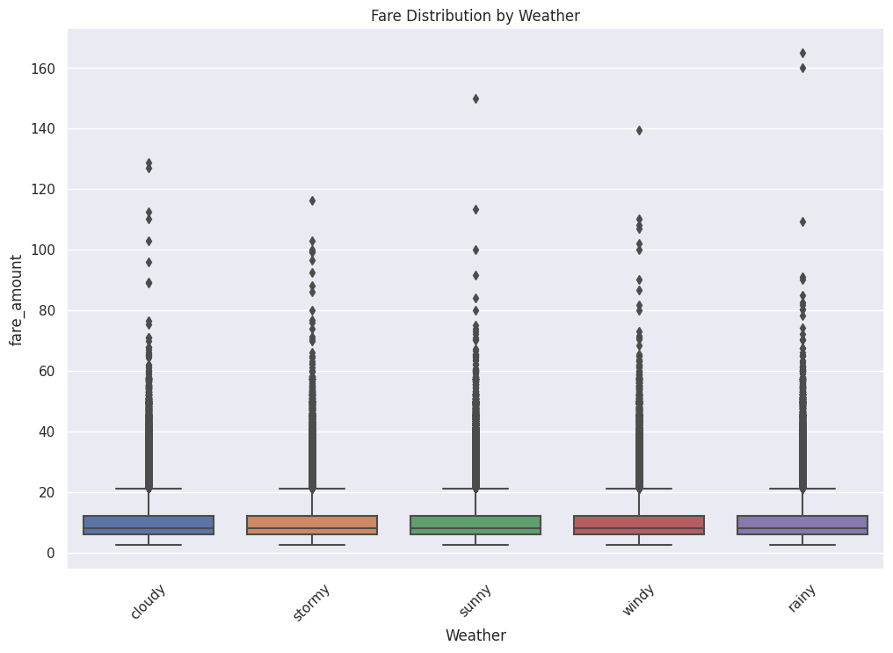
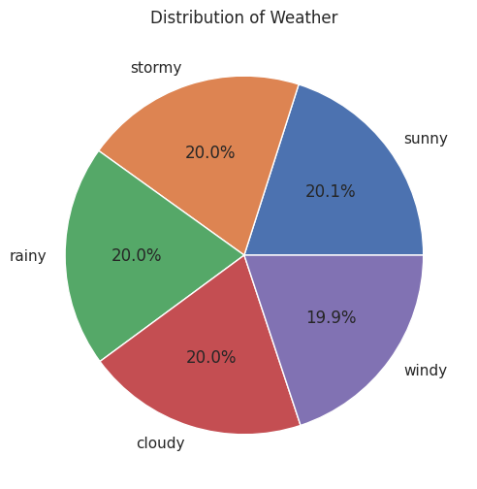
Key Insights: Fare vs Weather
Weather has minimal impact on fare prices, as all categories show similar distributions.
Most fares remain under $25, regardless of conditions.
Outliers exist in all weather types, suggesting other factors (e.g., distance, demand) drive high fares.
Conclusion: Weather does not significantly affect fare prices, implying no surge pricing based on weather conditions.

Slide 24
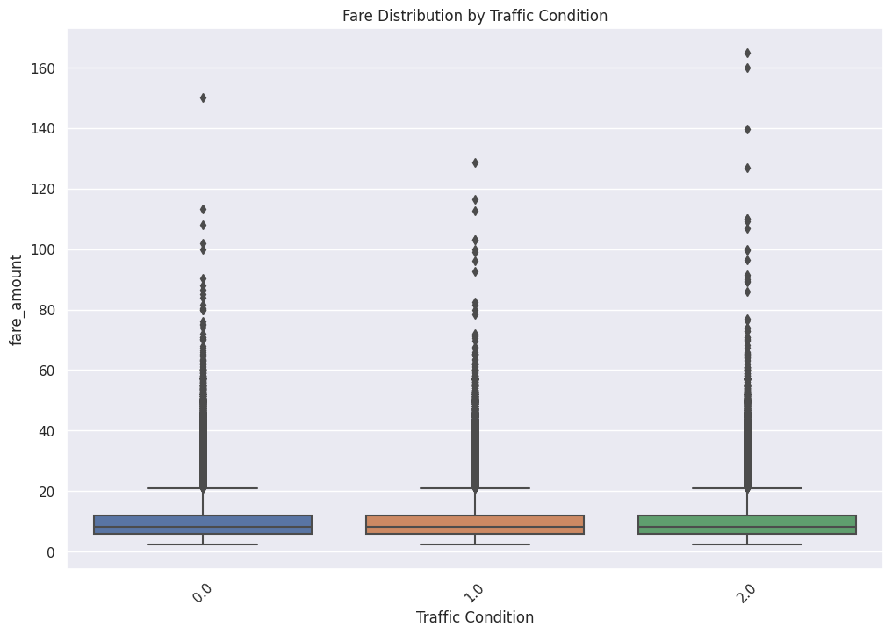
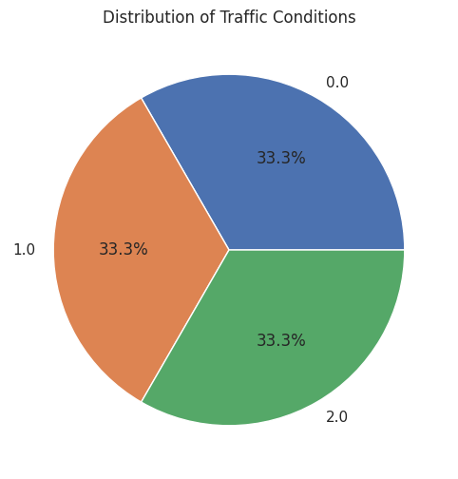
Key Insights: Fare vs Traffic Condition
Traffic conditions have little impact on fare prices, as distributions remain similar across all levels.
Most fares stay below $25, regardless of traffic congestion.
High-fare outliers appear in all traffic conditions, suggesting pricing is not significantly affected by traffic.
Conclusion: Traffic congestion does not influence fare pricing, likely due to fixed rates rather than time-based charges.

Slide 25
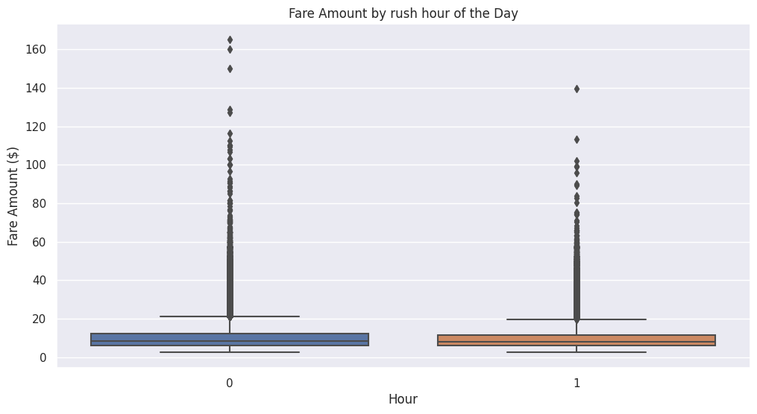
Key Insights: Fare vs Rush Hour
Rush hour fares are similar to non-rush hour fares, indicating no major price surges.
Most fares remain under $25, with outliers appearing in both time periods.
High fares exist during both rush and non-rush hours, suggesting pricing is driven more by distance than time of day.
Conclusion: Rush hour does not significantly impact fare prices, likely due to flat-rate or distance-based pricing.

Slide 26
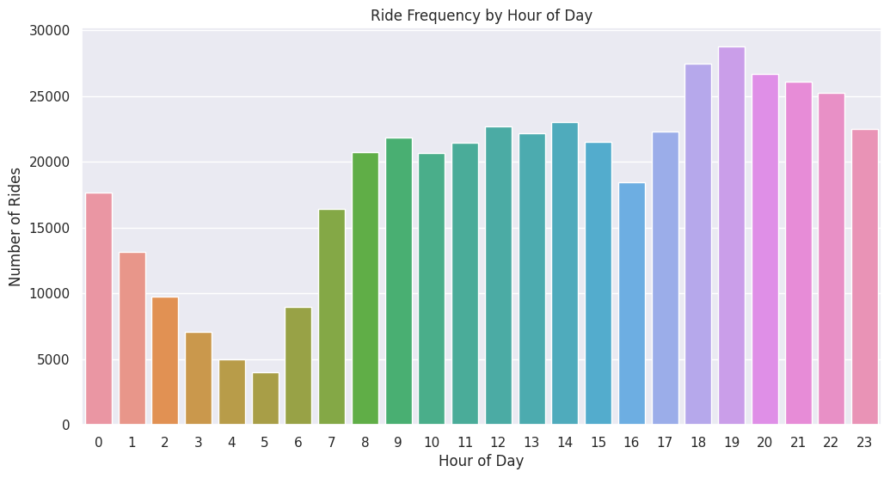
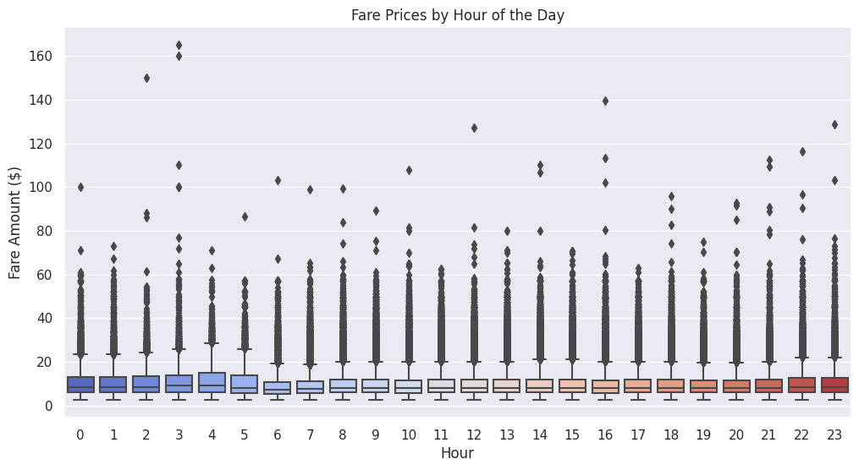
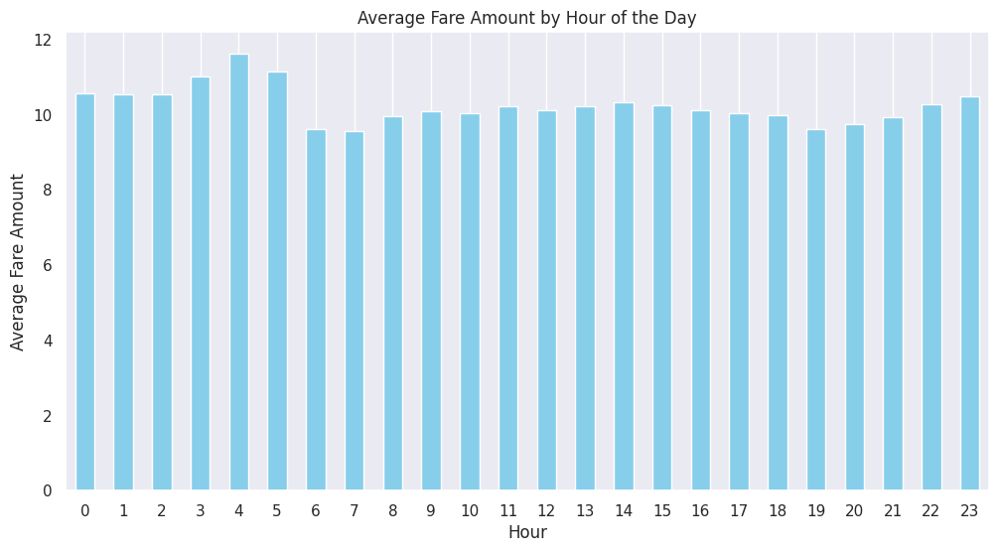
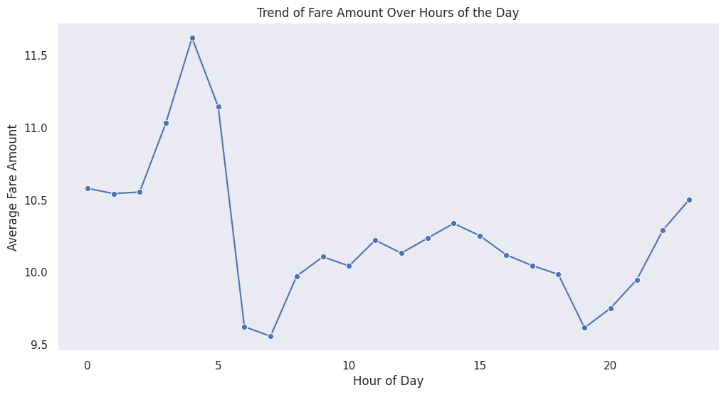
Key Insights: Fare by Hour of the Day
Fares peak between 3 AM - 5 AM, possibly due to airport trips or late-night demand.
Morning fares (6 AM - 9 AM) dip slightly, suggesting more short, routine commutes.
Evening fares (after 10 PM) rise again, likely due to nighttime demand or surge pricing.
Conclusion: Fare pricing fluctuates slightly throughout the day, with early morning and late-night fares being higher.

Slide 27
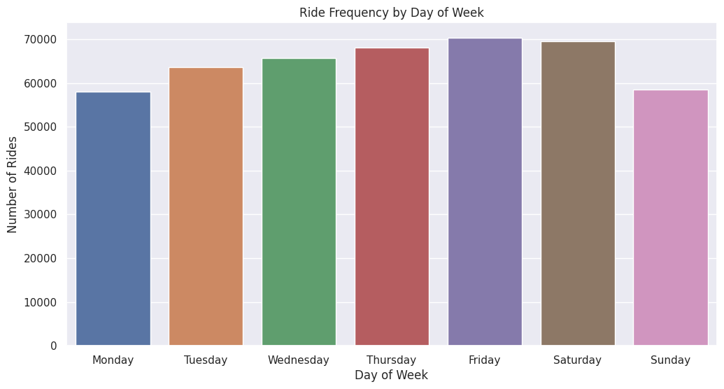
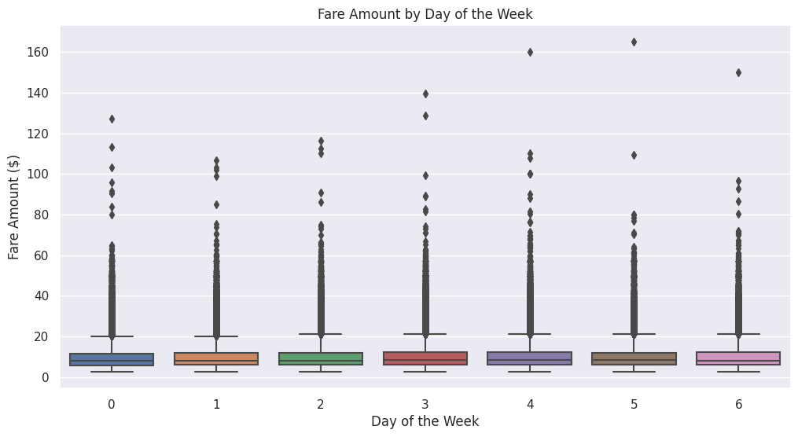
Key Insights: Fare vs Day of the Week
Rush hour fares are similar to non-rush hour fares, indicating no major price surges.
Most fares remain under $25, with outliers appearing in both time periods.
High fares exist during both rush and non-rush hours, suggesting pricing is driven more by distance than time of day.
Conclusion: Rush hour does not significantly impact fare prices, likely due to flat-rate or distance-based pricing.

Slide 28
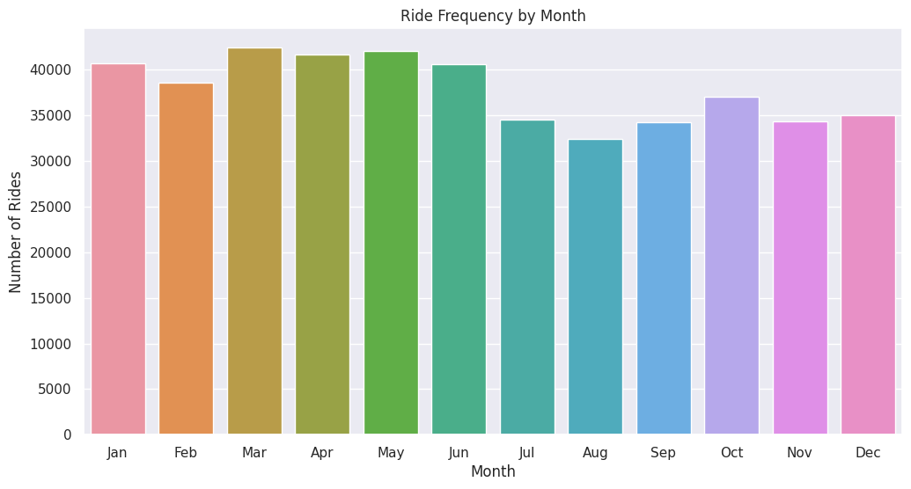
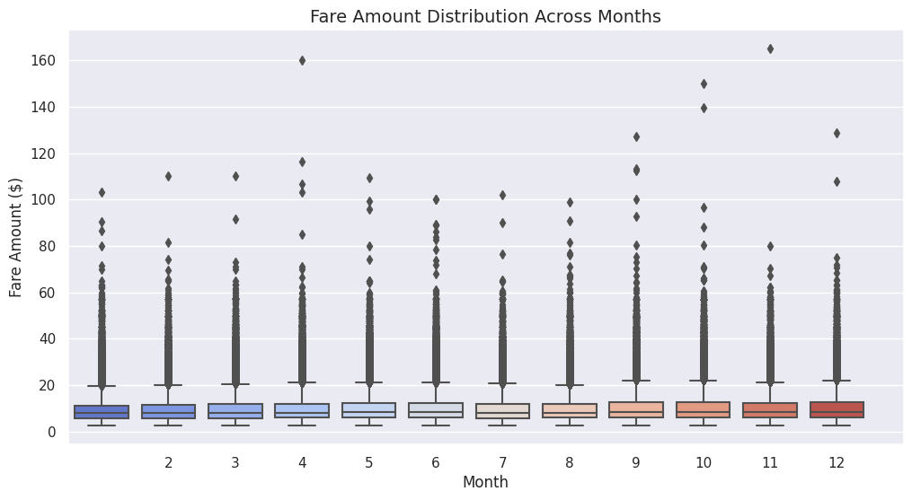
Key Insights: Monthly Trends in Fare & Ride Volume
Fares remain stable year-round, with most trips under $25 and occasional high-fare outliers.
Ride demand peaks from March to June, dips in July-August, and stabilizes in winter months.
No major seasonal fare surges, suggesting consistent pricing despite demand fluctuations.
Conclusion: Spring sees the highest taxi demand, but fares remain steady throughout the year.

Slide 29
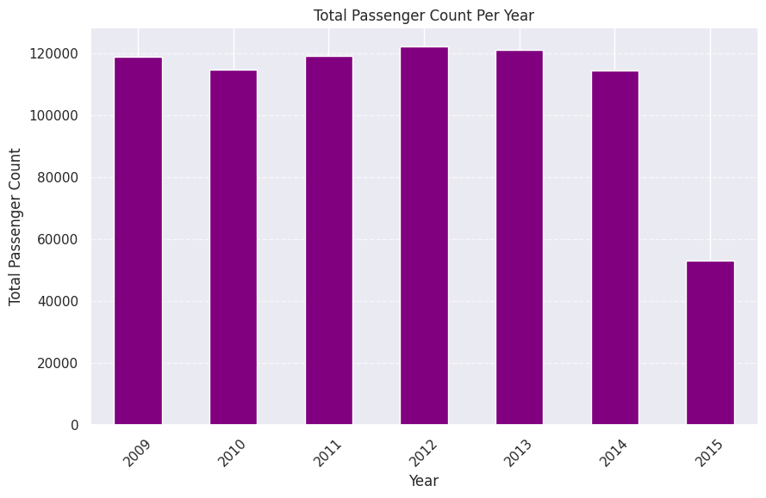
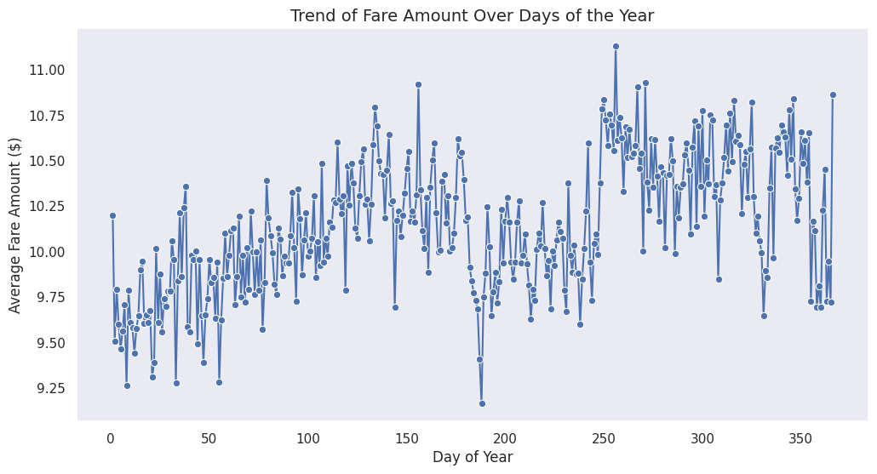
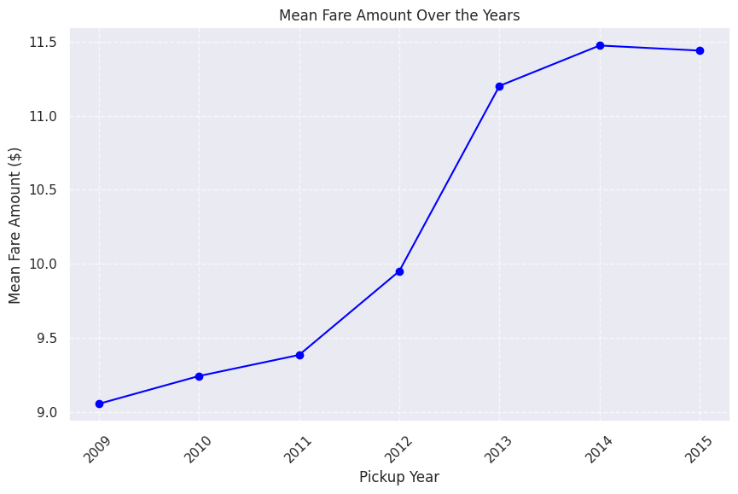
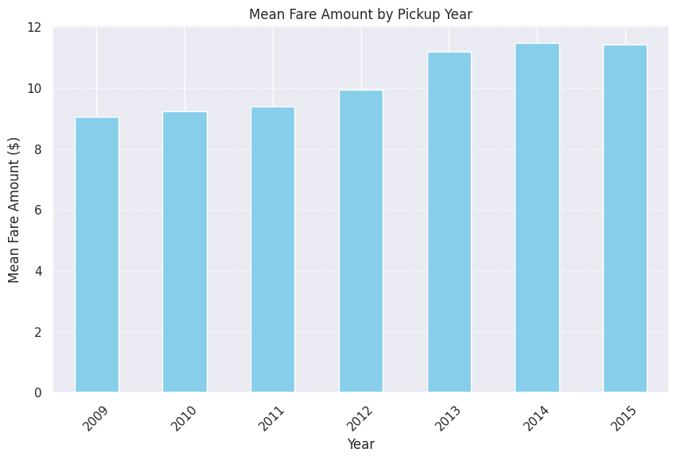
Key Insights: Total Passenger Count Per Year
Passenger count remained stable from 2009 to 2013, with minor fluctuations.
A decline in 2014, followed by a sharp drop in 2015, possibly due to competition from ride-sharing services.
2012 saw the highest passenger volume, indicating peak taxi demand.
Conclusion: Taxi ridership declined after 2013, likely due to emerging ride-sharing alternatives.

Slide 30
Conclusion: Key Findings & Future Implications
Distance is the Primary Fare Driver
In this analysis, we explored New York Taxi Fare data to understand the key factors influencing fare pricing, ride patterns, and demand trends. Through comprehensive EDA and feature engineering, we uncovered valuable insights that can enhance pricing strategies, improve operational efficiency, and optimize customer experiences.
100 %
Trip distance directly influences fares, with longer trips leading to higher charges.
Manhattan-centric rides & airport trips impact pricing trends.
25 %
External Factors Have Minimal Impact
%
Traffic, weather, and time-based features have little effect on fares.
Fare pricing remains stable across different days, months, and rush hours.

Slide 31
Key Takeaways from Taxi Fare Analysis
Distance is the Main Fare Driver
Stable Pricing Year-Round
Passenger Decline Post-2014
Longer trips mean higher fares, while traffic and weather have little impact.
Fares remain consistent across weekdays, weekends, and seasons, with some outliers.
Likely due to ride-sharing competition impacting taxi usage.
Manhattan is the Ride Hub
Peak Demand at Night & Early Morning
Most trips start and end in central NYC, with some extending to airports.
Airport trips and nightlife drive higher ride activity.

Slide 32
Implications & Future Scope
Fare Optimization
Operational Efficiency
Adjust pricing strategies based on peak hours and demand trends.
Improve taxi availability in high-demand locations and time slots.
Further Research
Customer Experience Enhancement
Explore dynamic pricing, ride-sharing impact, and external economic factors.
Leverage insights to reduce wait times and improve service reliability.

Slide 33
Thanks!
By : Group 3
Mahmoud Ayman Samir
Hana Alaaeldin Saleh
Mahmoud shawky

